Slide 1

Certificate chains explanation and hands-on
Setembro 2019

Slide 2
Agenda
Contexto Geral
SSL
TLS
Chave publica e privada
Certificado Digital
Quem pode gerar um certificado?
Cadeia de certificados
Métodos de criptografia
Hands-on
Gerando certificado com CA e Server
Gerando certificado com CA, Inter e Server

Slide 3
ssl, tls e certificados

Slide 4
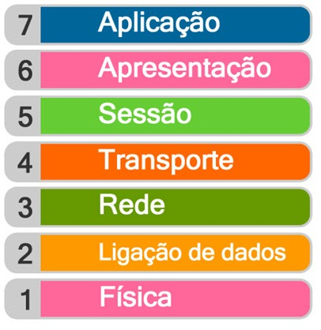
Contexto geral
Necessidade de trocar informações sensíveis usando canais inseguros
Modelo OSI não garante segurança

Slide 5
SSL Context
Protocolo de criptografia feito para prover comunicação segura através de um canal inseguro.
Usado por web-browsers, e-mail, voip, etc.
Versões:
1.0 (nunca foi lançada)
2.0 (deprecada 2011)
3.0 (deprecada 2015)

Slide 6
TLS Context
Protocolo de criptografia feito para prover comunicação segura através de um canal inseguro.
Sucessor do SSL
Versões:
1.0 (1999)
1.1 (2006)
1.2 (2008) – Mais usada atualmente
1.3 (2018)

Slide 7
CIFRAS

Slide 8
Korose – Introducação criptografia (cap 8)
Pq precisa de criptografia

Slide 9
Chave simétrica
Qual o problema se a chave vazar?

Slide 10
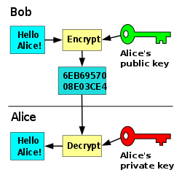
Private/Public Keys
Quick overview
Private Key
Public Key

Slide 11
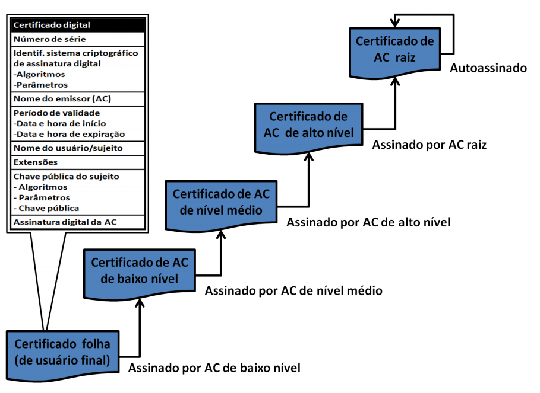
Certificado Digital
Overview
Para que é usado?
O que há dentro de um certificado?
Tipos de ataque man in de middle (roteador mudar o dns)
Fake site do Santander (não vai ter o cadeado)

Slide 12
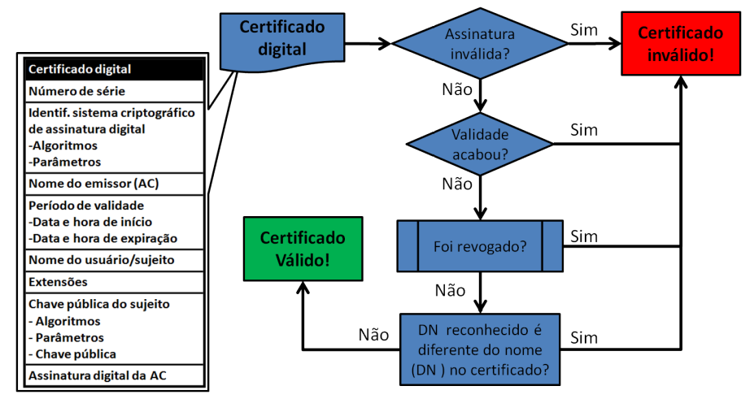
Certificado Digital
Validação
Notes:
Pq tem vezes q consigo prosseguir e tem site q não dá pra continuar?

Slide 13
Quem pode gerar um certificado?
CAs
Self Signed
Casos de revogação de CA
https://wiki.mozilla.org/CA:Symantec_Issues
Notes:
Caso de Revogação
Between 2009 and 2015, Symantec issued a large number of test certificates in their publicly trusted hierarchies. These contained domains that Symantec did not own or control, and for which domain validation was not performed. Some of these domains were unregistered, and others were owned by other organizations. Issuing test certificates for unregistered domains was not a BR violation before 3rd April 2014 (ballot 112), because they counted as Internal Server Names, but they continued the practice even after that date. The registered domains used included those belonging to Google and Opera Software. Given the numbers involved, this sort of test certificate issuance appears to have been common practice at Symantec. Some of the test certificates (including one for www.google.com) left Symantec's network because they were logged in CT. (Symantec claim that no certificates left their network; however, it's not clear how this can be true, and clarification is being sought.) However, Symantec personnel would have had access to the public and private keys of the certs.

Slide 14
Tipos de validação de certificado
DV – Certificado com validação de Domínio
Para blogs e sites pessoais
Valida a posse do domínio
Exibe o cadeado de segurança
OV – Validação da empresa
Voltado para empresas e organizações sem fins lucrativos
Valida a posse do domínio e a organização
Exibe o cadeado de segurança
EV – Validação estendida
Para sites de comércio eletrônico
Valida a posse do domínio e o mais elevado nível de autenticação empresarial
Exibe o cadeado de segurança, o nome da empresa e a barra verde

Slide 15
Cadeia de certificados
Notes:
Onde guardar o AC raiz? – offiline
Mostrar a chain do uol

Slide 16
Key usage
Notes:
Key Us

Slide 17
métodos de criptografia

Slide 18
Notes:
Integridade, autencidade, etc

Slide 19
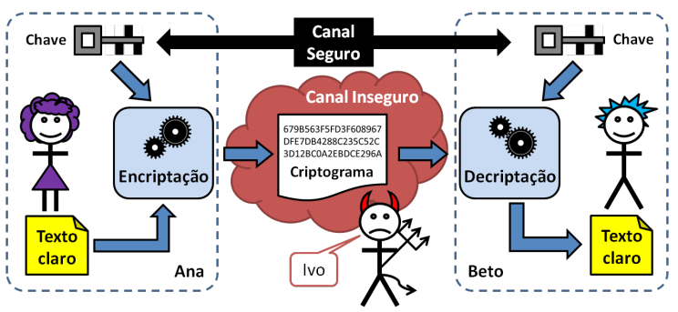
Métodos de criptografia
SYMMETRIC CRYPTOGRAPHY
Notes:
Colocar passos

Slide 20
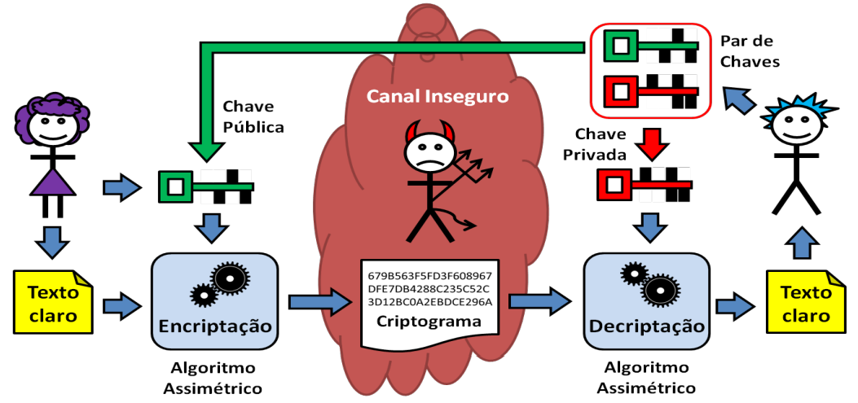
Métodos de criptografia
ASYMMETRIC CRYPTOGRAPHY FOR SECRECY

Slide 21
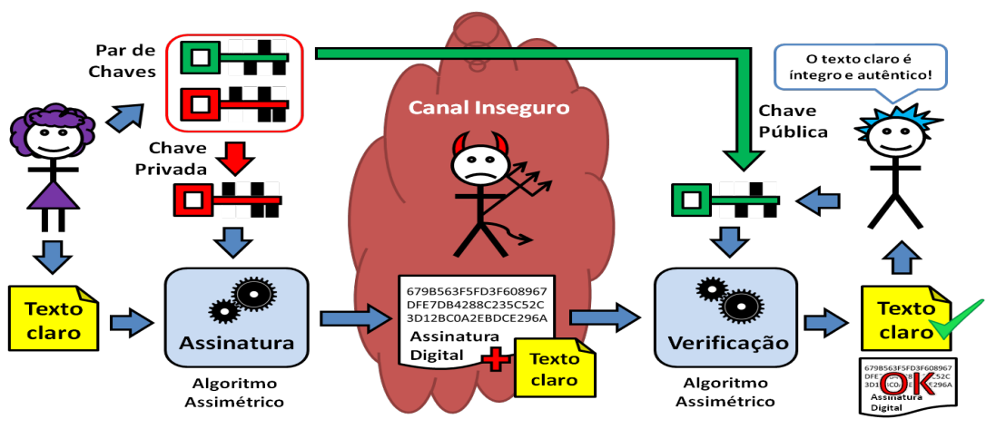
Métodos de criptografia
ASYMMETRIC CRYPTOGRAPHY FOR AUTHENTICITY

Slide 22
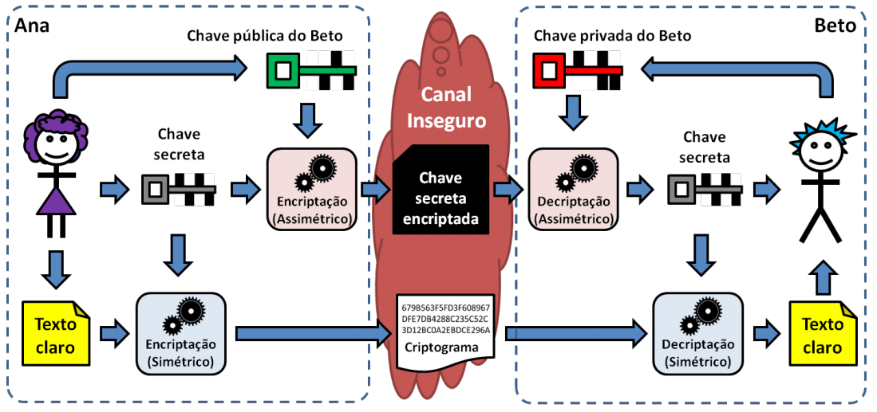
Métodos de criptografia
HYBRID CRYPTOGRAPHY
Notes:
Como vc garante que a chave publica é de uma pessoa

Slide 23
hands on

Slide 24
OpenSSL
INTRODUÇÃO
OpenSSL é uma implementação de código aberto dos protocolos de SSL e TLS.
Implementa funções básicas de criptografia para trabalhar com certificados digitais
Notes:
OpenSSL is a free and open-source cryptographic library that provides several command-line tools for handling digital certificates. Some of these tools can be used to act as a certificate authority.
A certificate authority (CA) is an entity that signs digital certificates. Many websites need to let their customers know that the connection is secure, so they pay an internationally trusted CA (eg, VeriSign, DigiCert) to sign a certificate for their domain.
In some cases it may make more sense to act as your own CA, rather than paying a CA like DigiCert. Common cases include securing an intranet website, or for issuing certificates to clients to allow them to authenticate to a server (eg, Apache, OpenVPN).

Slide 25
Criando seu self-signed certificate
Criar chave privada
openssl genrsa –aes256 –out rootCA.key
aes (advanced encryption standard) 256bits
Criar certificado root (CA)
openssl req –x509 –new –nodes –key rootCA.key –days 3650 –out rootCA.pem
req
x509
Padrão para infraestruturas de chaves públicas
Formato dos certificados digitais
days
How long till expiry of a signed certificate - def 30 days
Nodes
no DES, it means that openssl will not encrypt private key in cert file

Slide 26
Criar chave privada do certificado
openssl genrsa –aes256 –out private.key
Criar CSR (Certificate Signing Request)
openssl req –new –key private.key –out private.csr
Sign CSR with rootCA
openssl x509 -req –in private.csr –CA rootCA.pem –CAkey rootCA.key –CAcreateserial –out private.crt –days 3650
Change certificate to tomcat server be able to read it
openssl pkcs12 –export –in private.crt –inkey private.key –out private.p12
Use java keytool to generate JKS
keytool –importkeystore –srckeystore private.p12 –srcstoretype PKCS12 -destkeystore –private.jks –deststoretype JKS
Notes:
CSR é um arquivo contendo as informações para a solicitação do seu certificado
Ver o crt
openssl x509 –in cerfile.crt –noout -text

Slide 27
Self signed fast for tests
Quick way to generate a fast localhost certificate for testing
https://letsencrypt.org/docs/certificates-for-localhost/
openssl req -x509 -out localhost.crt -keyout localhost.key -newkey rsa:2048 -nodes -sha256 -subj '/CN=localhost' -extensions EXT -config <( \ printf "[dn]\nCN=localhost\n[req]\ndistinguished_name = dn\n[EXT]\nsubjectAltName=DNS:localhost\nkeyUsage=digitalSignature\nextendedKeyUsage=serverAuth")
Notes:
Acting as a certificate authority (CA) means dealing with cryptographic pairs of private keys and public certificates. The very first cryptographic pair we’ll create is the root pair. This consists of the root key (ca.key.pem) and root certificate (ca.cert.pem). This pair forms the identity of your CA.
Typically, the root CA does not sign server or client certificates directly. The root CA is only ever used to create one or more intermediate CAs, which are trusted by the root CA to sign certificates on their behalf. This is best practice. It allows the root key to be kept offline and unused as much as possible, as any compromise of the root key is disastrous.

Slide 28
At its core an X.509 certificate is a digital document that has been encoded and/or digitally signed according to RFC 5280.
Encodings (also used as extensions)
.DER = The DER extension is used for binary DER encoded certificates. These files may also bear the CER or the CRT extension. Proper English usage would be “I have a DER encoded certificate” not “I have a DER certificate”.
.PEM = The PEM extension is used for different types of X.509v3 files which contain ASCII (Base64) armored data prefixed with a “—– BEGIN …” line.
Common Extensions
.CRT = The CRT extension is used for certificates. The certificates may be encoded as binary DER or as ASCII PEM. The CER and CRT extensions are nearly synonymous. Most common among *nix systems
CER = alternate form of .crt (Microsoft Convention) You can use MS to convert .crt to .cer (.both DER encoded .cer, or base64[PEM] encoded .cer) The .cer file extension is also recognized by IE as a command to run a MS cryptoAPI command (specifically rundll32.exe cryptext.dll,CryptExtOpenCER) which displays a dialogue for importing and/or viewing certificate contents.
.KEY = The KEY extension is used both for public and private PKCS#8 keys. The keys may be encoded as binary DER or as ASCII PEM.

Slide 29
Hands on com certificado intermediário
Gerando o certificado intermediário
Já temos nosso rootCA.pem
Converter nosso .pem para .crt que vai ser usado no intermediário
openssl x509 –outform der –in rootCA.pem –out rootCA.crt
Gerar o inter.csr
openssl req –new –newkey rsa:2048 –sha256 –nodes –out inter.csr –keyout inter.key –config inter.cfg
Assinar nosso intermediário com o rootCA
openssl x509 –req -CA rootCA.pem –CAkey rootCA.key –CAcreateserial -in inter.csr –out inter.crt –extfile inter.cfg –extensions v3_ca
Gerar o .pem do inter
openssl x509 –outform PEM –in inter.crt –out inter.pem
Notes:
[ req ]
distinguished_name = req_distinguished_name
[req_distinguished_name]
countryName = Country Name (NL)
stateOrProvinceName = State or Province Name (ZH)
localityName = Locality Name (AADR)
organizationName = Organization Name (WGE)
commonName = Common Name (e.g. server FQDN)
[ ca ]
default_ca = myca
[ crl_ext ]
issuerAltName=issuer:copy
authorityKeyIdentifier=keyid:always
[ myca ]
dir = ./
new_certs_dir = $dir
unique_subject = no
certificate = rootCA.crt
database = certindex
private_key = rootCA.key
serial = certserial
default_days = 730
default_md = sha256
policy = myca_policy
x509_extensions = myca_extensions
crlnumber = crlnumber
default_crl_days = 730
[ myca_policy ]
commonName = supplied
stateOrProvinceName = supplied
countryName = optional
emailAddress = optional
organizationName = supplied
organizationalUnitName = optional
[ myca_extensions ]
basicConstraints = critical,CA:TRUE
keyUsage = critical,any
subjectKeyIdentifier = hash
authorityKeyIdentifier = keyid:always,issuer
keyUsage = digitalSignature,keyEncipherment,cRLSign,keyCertSign
extendedKeyUsage = serverAuth
[ v3_ca ]
basicConstraints = critical,CA:TRUE,pathlen:0
keyUsage = critical,any
subjectKeyIdentifier = hash
authorityKeyIdentifier = keyid:always,issuer
keyUsage = digitalSignature,keyEncipherment,cRLSign,keyCertSign
extendedKeyUsage = serverAuth

Slide 30
Hands on com certificado intermediário
Gerando o certificado do servidor com o Intermediário
Gerar a private key e o csr usando o server.cfg
openssl req -new -newkey rsa:2048 -sha256 -nodes -out private.csr -keyout private.key -config server.cfg
Assinar o .crt com o CA intermediário
openssl x509 -req -CA inter.pem -CAkey inter.key -CAcreateserial -days 2880 -in private.csr -out private.crt -extfile server.cfg -extensions v3_req
Juntar o CA root e o CA intermediário em um arquivo só
cat rootCA.pem inter.pem > bundle.pem
Exportar .p12 com a cadeia inteira de certificados
openssl pkcs12 -export -in private.crt -inkey private.key -out private.p12 -chain -CAfile bundle.pem
Notes:
[ req ]
distinguished_name = req_distinguished_name
req_extensions = v3_req
[req_distinguished_name]
countryName = Country Name (NL)
stateOrProvinceName = State or Province Name (ZH)
localityName = Locality Name (AADR)
organizationName = Organization Name (WGE)
commonName = Common Name (e.g. server FQDN)
[ v3_req ]
subjectAltName = DNS:localhost,IP:105.103.135.58,IP:105.103.83.24
extendedKeyUsage = serverAuth, clientAuth

Slide 31
Repositório
https://github.com/felipetortella/ap-pucc-certificate

Slide 32
show certificate
on spring boot
Notes:
Preparar uma versão do spring boot com o certificado, mostrar:
- rodando o http
- rodando com https sem instalar o root
- rodando com https com o root instalado
- fazer o demo chamando com o certificado sem alt name pro IP (usando localhost)
- colocar o certificado com o intermediário e mostrar funcionando localhost e alt name ip
Demo está no Linux em Apresentações

Slide 33
LINKS
Notes:
https://searchsecurity.techtarget.com/definition/digital-certificate
https://www.comodo.com/resources/small-business/digital-certificates.php
https://letsencrypt.org/docs/certificates-for-localhost
TLS v1.2 Protocol Detailed Flow
https://tls.ulfheim.net/
Introdução à criptografia para administradores de sistemas com TLS, OpenSSL e Apache mod_ssl.
Alexandre Braga (UNICAMP)
Ricardo Dahab (UNICAMP)

Slide 34
Obrigado,

